Slide 1



1
COD892: MTP-1
Network Traffic Analysis
Instructor : Prof. Vireshwar Kumar & Prof. Tarun Mangla
2nd August 2024
Sajal Verma & Manish Kumar
[2023MCS2490] [2023MCS2497]

Slide 2
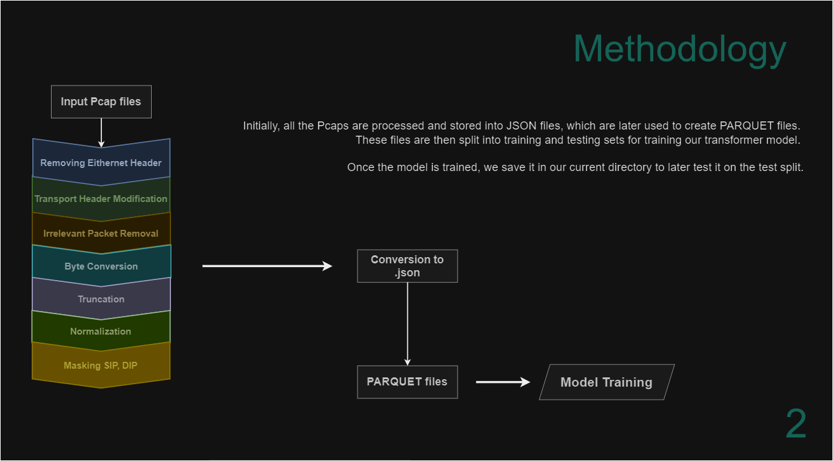

Slide 3
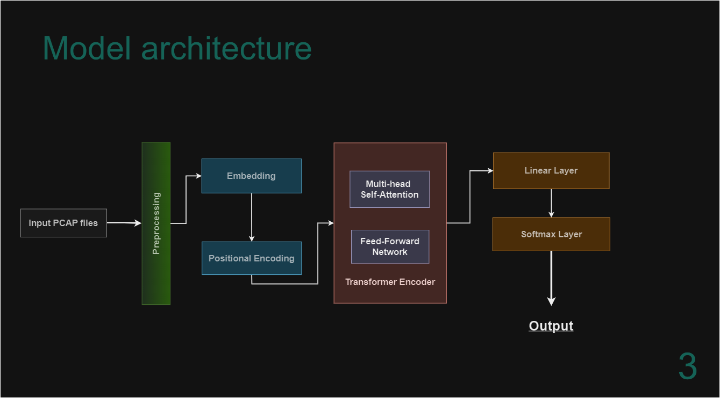

Slide 4
Model’s Processing Overview
Input :
The input stream of n/w packets have been byte normalized into vector of size [1 x 1500] after preprocessing.
We split the input PCAP file into batches of size 32 packets, as in model training/testing purpose. Following are the representation of input shapes & corresponding outputs at each step.
4

Slide 5
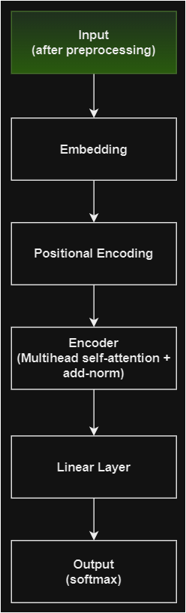
Input Layer
Batch Shape : [32 * 1 * 1500]
Values :
[0.2706, 0.0000, 0.0196, ..., 0.0000, 0.0000, 0.0000]
The 0 values at the end of 1D vector represents the 0-padded byte normalized packet.
Sample Packet
5

Slide 6
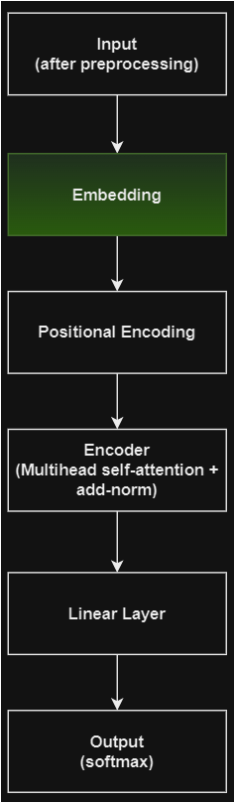
Embedding Layer
Shape : [32 * 1 * 512]
Values :
[[ 6.6401e-01, -8.0226e-01, 9.3528e-01, -8.3734e-01, 4.8165e-01,
-1.8923e-01, -8.1680e-01, -1.2730e-01, 1.5338e+00, -6.0097e-01,
7.7627e-01, 1.2493e-01, -9.9442e-01, 1.3910e-02, -4.4772e-01,
-8.0419e-01, 6.5931e-01, 4.5600e-01, -4.6872e-01, 9.9191e-01,
5.9315e-01, -5.6767e-02, -3.8005e-01, -3.5948e-01, -8.4539e-01,
-8.8392e-02, -1.6546e-01, -9.5731e-01, -5.7198e-01, 3.3244e-01,……], …x32]
The embedding layer transforms each sequence of 1500 B representation, into a 512-dimensional space.
6

Slide 7
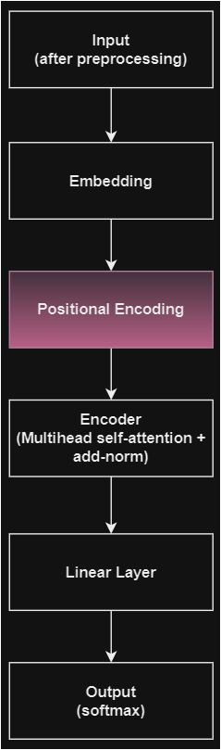
Positional Encoding
Shape : [32 * 1 * 512]
Values :
[[ 6.6401e-01, 1.9774e-01, 9.3528e-01, 1.6266e-01, 4.8165e-01,
8.1077e-01, -8.1680e-01, 8.7270e-01, 1.5338e+00, 3.9903e-01,
7.7627e-01, 1.1249e+00, -9.9442e-01, 1.0139e+00, -4.4772e-01,
1.9581e-01, 6.5931e-01, 1.4560e+00, -4.6872e-01, 1.9919e+00,
5.9315e-01, 9.4323e-01, -3.8005e-01, 6.4052e-01, -8.4539e-01,
9.1161e-01, -1.6546e-01, 4.2695e-02, -5.7198e-01, 1.3324e+00,……], …x32]
Here, we add the positional information to the embeddings, marking the order of tokens(as network flow) in the sequence.
7

Slide 8
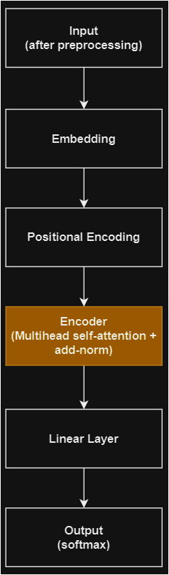
Encoder
Shape : [32 * 1 * 512]
Values :
[[ 3.6102e-02, 2.1616e-02, -6.6913e-01, -2.3399e-01, 2.7177e-01,
1.3855e+00, 1.5895e+00, 1.0015e+00, 2.2689e+00, -7.8036e-01,
2.9641e-03, -7.3155e-01, -1.3918e-01, 2.7215e-01, -3.1259e-02,
-2.5896e-03, -1.5216e-01, 2.5698e+00, -1.3940e-01, 4.4697e-01,
-1.1468e+00, 1.3132e+00, 1.1392e+00, -7.8431e-01, 1.5313e+00,
-6.0766e-01, 9.5209e-01, 9.2339e-01, -1.7054e-01, -1.6881e+00,……], …x32]
Utilizing Multihead self-attention (for Query-Key-Value products) & feedforward neural network, we try to capture the relationships in the data.
8

Slide 9
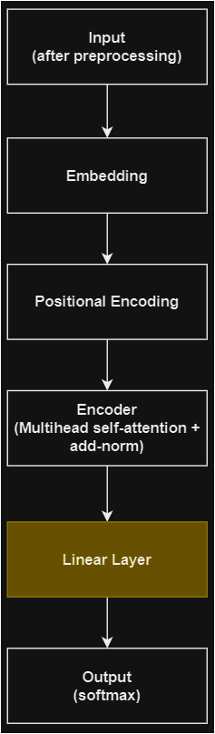
Linear Layer
Shape : [32 * 512]
Values :
[[ 3.6102e-02, 2.1616e-02, -6.6913e-01, -2.3399e-01, 2.7177e-01,
1.3855e+00, 1.5895e+00, 1.0015e+00, 2.2689e+00, -7.8036e-01,
2.9641e-03, -7.3155e-01, -1.3918e-01, 2.7215e-01, -3.1259e-02,….
-2.1193e+00, 6.3814e-01, 2.1412e-01, -6.0550e-01, 3.9612e-01,
-2.0971e+00, -1.9823e+00, 4.2493e-01, -5.1902e-01, -5.8562e-01,
-3.8708e-01, 6.8989e-01, -5.0214e-02, 6.5039e-01, 7.6786e-01], ……x32]
Linear layer averages the encoded features along the seq. length dimension, efficiently summarizing the sequence info.
9

Slide 10
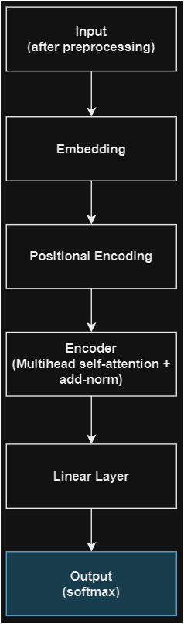
SoftMax Layer
Shape : [32 * 17]
Values :
[[-1.0983, -2.0180, -0.5392, 0.5478, 0.5895, -0.0263, -1.9900, 1.2022,
0.9265, 1.5904, 1.6805, 1.5644, 1.3385, -1.6477, 1.7192, -4.5699,
-3.7421],
[ 0.4238, 0.4657, 1.5976, -1.4737, 1.6218, 2.0000, -0.5061, -1.0178,
0.1165, 1.5422, 1.8515, 0.5965, -1.1521, 1.2190, 0.0732, -4.5766,
-3.9063],
[-1.6638, -2.3327, -1.7375, 1.7760, -0.2808, -1.7101, -2.3349, 2.0536,
2.0591, 2.4262, 0.7882, 1.5694, 2.2375, -2.5453, 2.0682, -3.9188,
-3.4516],……x32]
Represents the max. possible match for i^{th} packet to certain class from the set of expected classes of application data.
YouTube
Hangouts
SFTP
10

